Slide 1
BASIS PURSUIT
By Rohith G

Slide 2
ADMM
ADMM is an algorithm that solves convex optimization problems by breaking them into smaller pieces, each of which are then easier to handle.
Powerful iterative algorithm.
80 times faster than conventional methods.
Put linear and quadratic programming in a single frame work.
Used for statistical problems with huge data sizes.
Applications of ADMM.

Slide 3
BASIS PURSUIT
Basis pursuit is a equality constrained L1 minimization problem.
It is often used as a heuristic for finding solution for underdetermined system of linear equation.
It is used in signal processing

Slide 4
BASIS PURSUIT
In ADMM form it can be written as,
Minimize
augmented Lagrangian as,
Subject to
where f is a indicator function of
Now we are doing several iterations of,

Slide 5
BASIS PURSUIT
x-update:
z-update:
We use strinkage operation by
towards 0,
If it does’nt satisfy the equation Az=b.

Slide 6
Solving Basis Pursuit:
Formation of Lagrangian and solving the problem is as follows:
|x| +( x - c )² Is the reference for shrinkage

Slide 7
New Term: Shrinkage Function
The latter part of the added term in x-update is called the penalty or the regularisation function.
The shrinkage function sets all values of y less than linear multiplier of x(𝞴 in our case) to zero.

Slide 8
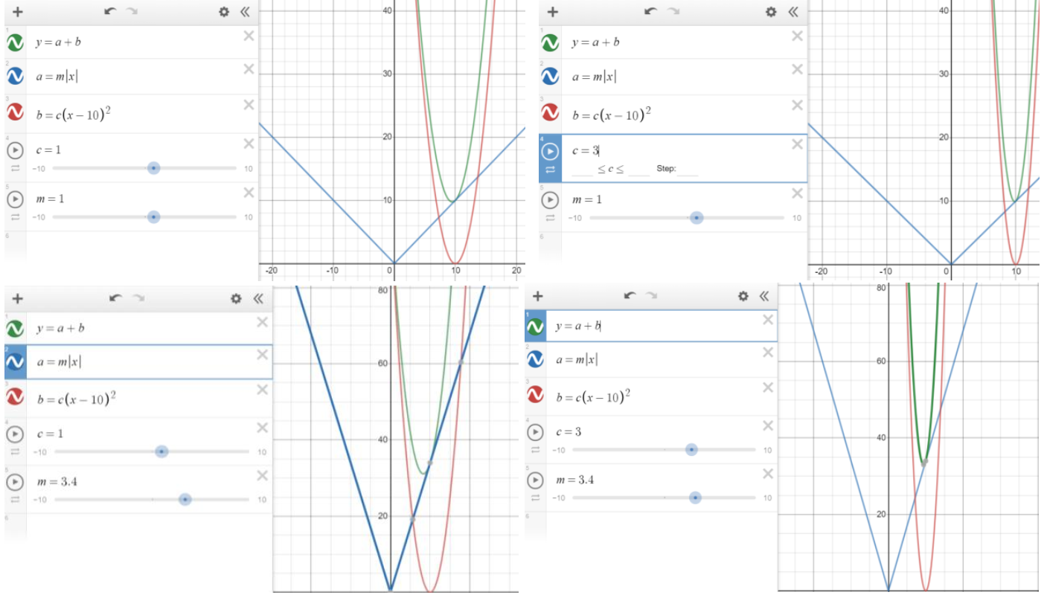
Graphical Representation

Slide 9
Code to execute:
Sample Input:
function [x,z,u] = basis_pursuit(A, b, rho, alpha)
MAX_ITER = 1000;
[m n] = size(A);
x = zeros(n,1); z = zeros(n,1); u = zeros(n,1);
% precompute static variables for x-update (projection on to Ax=b)
AAt = A*A';
P = eye(n) - A' * (AAt \ A);
q = A' * (AAt \ b);
for k = 1:MAX_ITER
% x-update
x = P*(z - u) + q;
% z-update with relaxation
zold = z;
x_hat = alpha*x + (1 - alpha)*zold;
z = shrinkage(x_hat + u, 1/rho);
u = u + (x_hat - z);
end
end
function y = shrinkage(a, kappa)
y = max(0, a-kappa) - max(0, -a-kappa);
end
clc;clear all;close all;
n = 30;
m = 10;
A = randn(m,n);
x = sprandn(n, 1, 0.1*n);
b = A*x;
xtrue = x;
[X,Z,U] = basis_pursuit(A, b, 1.0, 1.0);

Slide 10
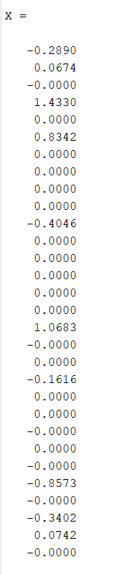
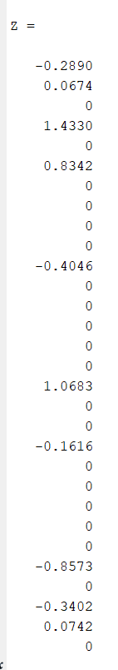
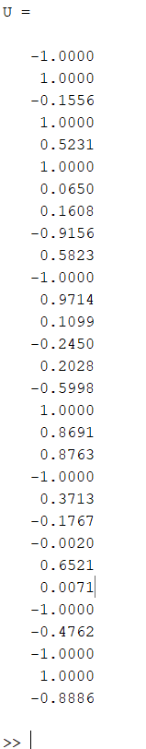
MATLAB Output

Slide 11
Denoising
Filtering of the unwanted waves (ie)Noise from the signal is called signal denoising
Thresholding is a technique used for signal and image denoising.
The discrete wavelet transform uses two types of filters:
1. averaging filters
2. detail filters.
Basis pursuit denoising has potential applications in statistics

Slide 12
Denoising using Basis pursuit
clc;clear all;close all;
n = 300;
m = 10;
A = randn(m,n);
x = sprandn(n, 1, 0.1*n);
b = A*x;
xtrue = x;
[X,Z,U] = basis_pursuit(A, b, 1.0, 0.003);
subplot(2,1,1)
plot(x)
xlabel('Time');
ylabel('Amplitude')
title("Noisy signal");
subplot(2,1,2)
plot(X)
xlabel('Time');
ylabel('Amplitude')
title("Denoised signal");
function [x,z,u] = basis_pursuit(A, b, rho, alpha)
% basis_pursuit Solve basis pursuit via ADMM
MAX_ITER = 1000;
[m n] = size(A);
x = zeros(n,1);
z = zeros(n,1);
u = zeros(n,1);
% precompute static variables for
% x-update (projection on to Ax=b)
AAt = A*A';
P = eye(n) - A' * (AAt \ A);
q = A' * (AAt \ b);
for k = 1:MAX_ITER
% x-update
x = P*(z - u) + q;
% z-update with relaxation
zold = z;
x_hat = alpha*x + (1 - alpha)*zold;
z = shrinkage(x_hat + u, 1/rho);
u = u + (x_hat - z);
end
end
function y = shrinkage(a, kappa)
y = max(0, a-kappa) - max(0, -a-kappa);
end

Slide 13
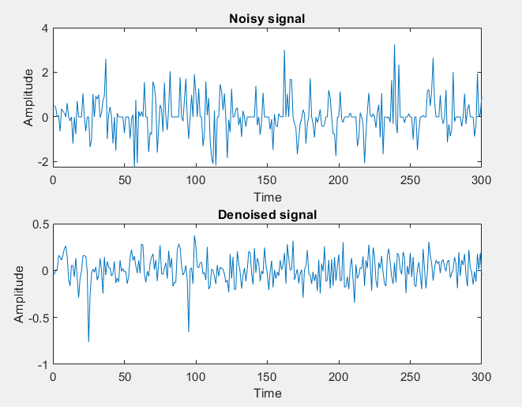
MATLAB Output

Slide 14
THANK YOU
“We cannot solve our problems with the same thinking we used when we created them”
By
ALBERT EINSTEIN

